Slide 1

Memory Skills Group
Week 5 : Mood and Cognitive Functioning
Rebecca Niebieszczanski (Trainee Clinical Psychologist)
Kirsty Ellis (Assistant Psychologist)
Lesley Stewart (Consultant Clinical Neuropsychologist)
Revised 2021
Grace Sunerton (Assistant Psychologist)
Alice Roblin (Senior Clinical Psychologist)

Slide 2

Welcome!
Notes:
Welcome participants to the group
Explain that the group is for individuals who report difficulties with their memory
Important that we have realistic expectations that the group is not about ‘getting rid’ of our memory difficulties
The group will offer skills and information that will help us to manage these memory difficulties
2 hours with break

Slide 3




Housekeeping:
Notes:
Breaks – including toilet breaks
No recording of the session
Mobile phones on silent/vibrate to minimise distractions

Slide 4
Overview of the course:
Session 1 Introductions and an overview of cognitive abilities
Session 2 Overview of memory
Session 3 External memory enhancement strategies
Session 4 Internal memory enhancement strategies
Session 5 Mood and cognitive functioning
Session 6 Keeping well, course reviews and goodbyes
Notes:
Today we are going to focus on the interaction between our cognitive functioning and our mood/emotions. We’re going to think about the impact of our mood on our cognitive functioning and vice versa. Along the way we’ll also think of some small changes that we may be able to make, to have a positive impact on the way we feel and how, in turn this might also have a positive impact on our memory and cognition.

Slide 5

Session Outline
Welcome and grounding exercise
Summary of last session
Review of out of session work
What do we mean by mood?
How does mood impact memory?
Ways to improve wellbeing/mood
Out of session work
Summary

Slide 6
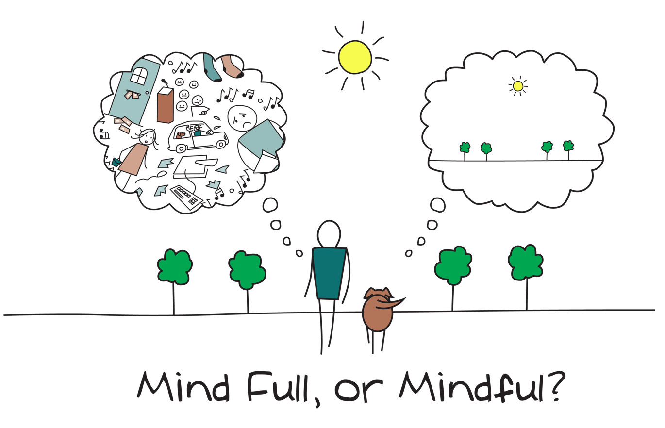
Mindfulness
Notes:
As we said in the last session, when you come into each session there may be lots of things on your mind. You might have thoughts about what you’ve been doing, what you need to do, maybe some expectations or perhaps worries about what the group itself will be like. Our minds often wander and life is sometimes filled with stresses or worries.
To start off today, and at the beginning of our future sessions, we will carry out a brief breathing exercise. The aim of this is just to help us be more present ‘in the moment’, and give us some time to become more aware of our thoughts, feelings and any physical sensations.
As we’ll see later in the course, this can also support our cognitive functioning and help our memory along with promoting overall well-being. If you have difficulty focusing on the breath (e.g. due to breathing difficulties) then go at a pace that feels comfortable to you, stop the meditation or focus on another part of your body, such as your feet.
Below are some of the core principles of mindfulness:
The ‘being’ mode: Mindfulness says that often we are so caught up in these thoughts about the past and future (the ‘doing’ mode) that we end up not paying attention to what’s happening around us now (the ‘being’ mode).
Self-compassion: We often have so much compassion and empathy for others that we forget to have the same for ourselves. Mindfulness is about extending some of this kindness to ourselves.
Mindfulness can have a positive impact on lots of areas of our lives including:
Emotional wellbeing: becoming more aware of our unhelpful thoughts and feelings and distancing ourselves from these. This can help us to realise that thoughts are just that thoughts! We will talk more about this in sessions 5 and 6.
Physical wellbeing: Becoming more aware of our bodies can be very useful for managing stress and reducing the release of cortisols. This is because we’re often not even aware of the impact of stress on our bodies. We will also discuss this in more detail in another session
Cognitive functioning: Mindfulness can be used to help improve our attention. By becoming aware of our thoughts, feelings and physical sensations we can bring our attention back to the present moment and reduce how much time we spend in automatic pilot. This can actually also help us to train our attention and help us to process and encode information effectively.

Slide 7
Last Session: Summary
Overview of internal memory strategies
Practice of internal memory strategy
Weekly goal
Notes:
Home practice: how was it? Any particular difficulties? Anything from previous session? Any strategies noted down?

Slide 8
Reviewing Weekly Goals
Trying out a new memory strategy for the week:
Were you able to do it?
Was it difficult to do?
Was it helpful/unhelpful?
Notes:
Home practice: how was it? Any particular difficulties? Anything from previous session? Any strategies noted down?

Slide 9
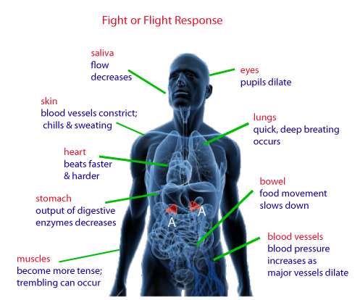
What do we mean by mood?
Positive or negative emotional states/feelings. But when we talk about ‘mood’ we usually mean the negative states.
Anxiety/worry:
Worrying thoughts about the past or future (e.g. something bad will happen)
Restless
Irritable
Physiological changes – heart/breathing rate increases, sweaty palms.

Slide 10

What do we mean by mood? (contd.)
Low mood/depression:
Negative thoughts about yourself (e.g. “I’m useless”)
Decreased interest in things you used to enjoy
Not gaining pleasure from anything
Loss of energy and motivation
People can feel both anxious and low/depressed at the same time.

Slide 11

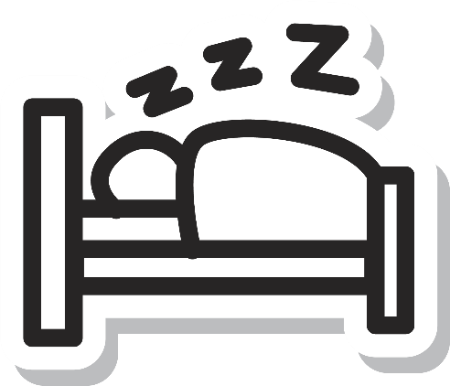
How Mood Impacts Memory – Negative Thinking
We tend to have negative thoughts when we feel anxious or low e.g. worries about the past or future + being self-critical.
Attention:
These thoughts distract us from what's going on around us e.g. what people are saying
If were not paying attention, we can’t process and remember the information.
Sleep:
Negative thinking/rumination can effect our sleep quality.

Slide 12
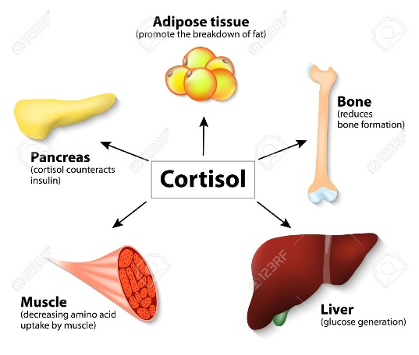
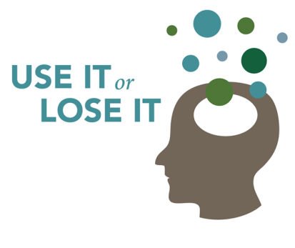
How Mood Impacts Memory (contd.)
Stress hormones:
When we’re stressed, the body releases cortisol and adrenaline
High levels of these hormones can affect your memory
Cognitive stimulation:
When we’re low/depressed we lose motivation e.g. not meeting friends + doing things you enjoy
Not using memory skills
Use it or lose it!

Slide 13
What helps you to feel relaxed, less stressed, happier?

Slide 14
Thought Cycles
Thoughts
Feelings
Physiological Changes
Behaviour
The way in which you think can influence the way you feel (emotionally and physically) which can then have an impact on your behaviour.

Slide 15
Example:
Situation: Notice Memory Difficulty
Thoughts "this is awful" "my memory is getting worse"
Feelings Worried Panicky Restless
Physiological Changes Increase in stress hormone Heart Races Shallow, fast breathing
Behaviour Cannot concentrate Difficulty Sleeping Asking for reassurance

Slide 16
Managing negative thoughts
Become aware of when you are getting ‘stuck’ in a pattern of negative thinking is a good start
Ask yourself:
What’s the worst that could happen? Is this likely?
If your friend told you they had these kinds of thoughts, what would you say to them?
Is there evidence to say that these thoughts are true? e.g. “I’m stupid”
Practice mindfulness strategies to ‘distance yourself’ from negative thoughts e.g. mindful breathing or progressive muscle relaxation.

Slide 18
General Wellbeing Tips
Reading a book
Having a long shower or bath
Having a nice meal, and really taking time to enjoy it
Walking and playing with a pet
Phoning a friend or going out for a catch up
Painting, making a collage, knitting, writing or drawing – anything you find soothing.

Slide 19

Mindfulness: distancing ourselves from out thoughts
Noticing and observing our thoughts + not getting caught up in them
Switching attention to something else e.g. breathing
Helps us realise thoughts are just thoughts
Helps us to get ‘present’.

Slide 20
Where to start with mindfulness
YouTube videos
Apps e.g. ‘Calm’ and ‘Headspace’
Worksheets

Slide 21
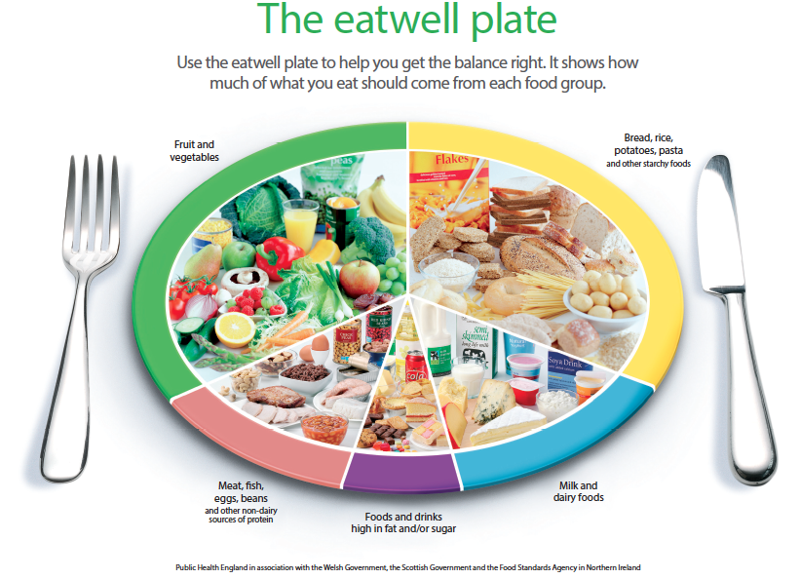
How a Balanced Diet Might Help
Balanced diet improves vascular health (helps keep cholesterol and blood pressure low). Poor vascular health affects brain health and functioning.

Slide 22

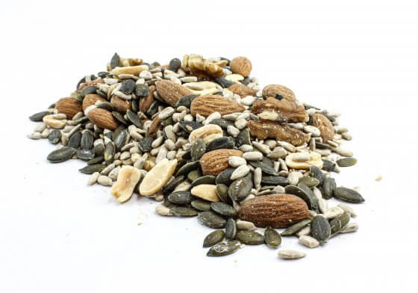
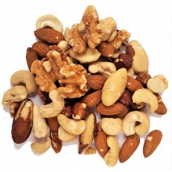

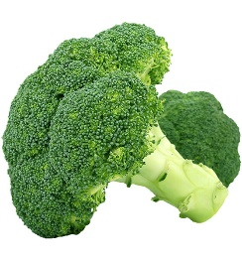


Foods for Better Brain Health & Memory
Brain health:
Omega 3 fatty acids (nuts, seeds, olive oils and oily fish)
Antioxidants (broccoli, blueberries, spinach)
Memory:
B Vitamins (especially B12)

Slide 23

Regular Exercise
Physical and brain health:
Improves blood pressure and reduces body weight – linked to various health problems
Improves blood flow to brain and mental performance
Mood:
Exercise boosts release of endorphins (‘feel good’ hormones) – reduce stress, anxiety or low-mood.
What is recommended?
Regular moderate level of exercise - 30 minutes, 5 days a week
Raising heartrate – running, sports etc. but can also be brisk walks, pushing lawnmower.

Slide 24
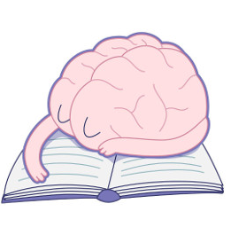
Why is Sleep Important For Memory?
Memories are consolidated in our sleep (deep sleep stages). Therefore Memory consolidation is affected if you don’t have enough sleep.
Lack of sleep/feeling tired can affect concentration and memory performance
For this, and other health-related, reasons 7-9 hours of sleep is recommended.

Slide 25



Sleep Hygiene
Regular sleep/wale up time
Only sleep when tired
Avoid caffeine and nicotine around 4-6 hours before going to bed Stimulants!
Avoid alcohol before bed – affects sleep quality!
Avoid napping in the day
Regular exercise but not less than 4 hours before bed
Warm bath 1 hour before bed
Sleep rituals e.g. breathing exercise 15 minutes before bed, cup of caffeine-free tea.

Slide 26
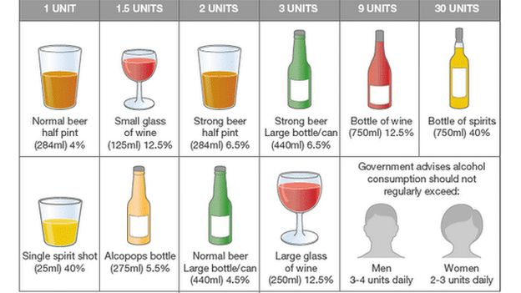
Alcohol Consumption
Excessive alcohol consumption impacts health, sleep quality, and cognitive functioning

Slide 27


Smoking and Caffeine
Smoking:
Cardio-vascular risk factor which can affect brain health (and therefore memory)
Related to lots of negative health problems
Caffeine:
Stimulant – harder to fall asleep
Some evidence it can affect short-term memory
Tea, coffee, chocolate, fizzy/energy drinks.

Slide 28
Session summary
Grounding exercise
Summary of last session
Review of out of session work
What do we mean by mood?
How does mood impact memory?
Ways to improve wellbeing/mood
Out of session work

Slide 29
Thank you for attending
Grace Sunerton, Assistant Psychologist
Jessica Haselhurst, Trainee Clinical Psychologist
01782 275188
Notes:
Contact details if you are having difficulties with the programme. There will also be space to ask any questions and explore with us your difficulties within the group if you feel comfortable sharing these.

